Slide 1


A Presentation
On
Engineering Mathematics-II
(BEML19102) By
Mr. MoienAhmad Borotikar
Faculty of Engineering Mathematics
F. Y. B. Tech. Dept.
G. H.Raisoni College of Engineering & Management, Wagholi -Pune

Slide 2
ENGINEERING MATHEMATICS-II COURSE CONTENTS
Integral Calculus
Curve Tracing
Multiple Integral
Application of Multiple Integral

Slide 3

UNIT – I : Integral Calculus
Gamma Function
Beta Function
Relation Between Beta and Gamma Function
Diff. under integral sign

Slide 4
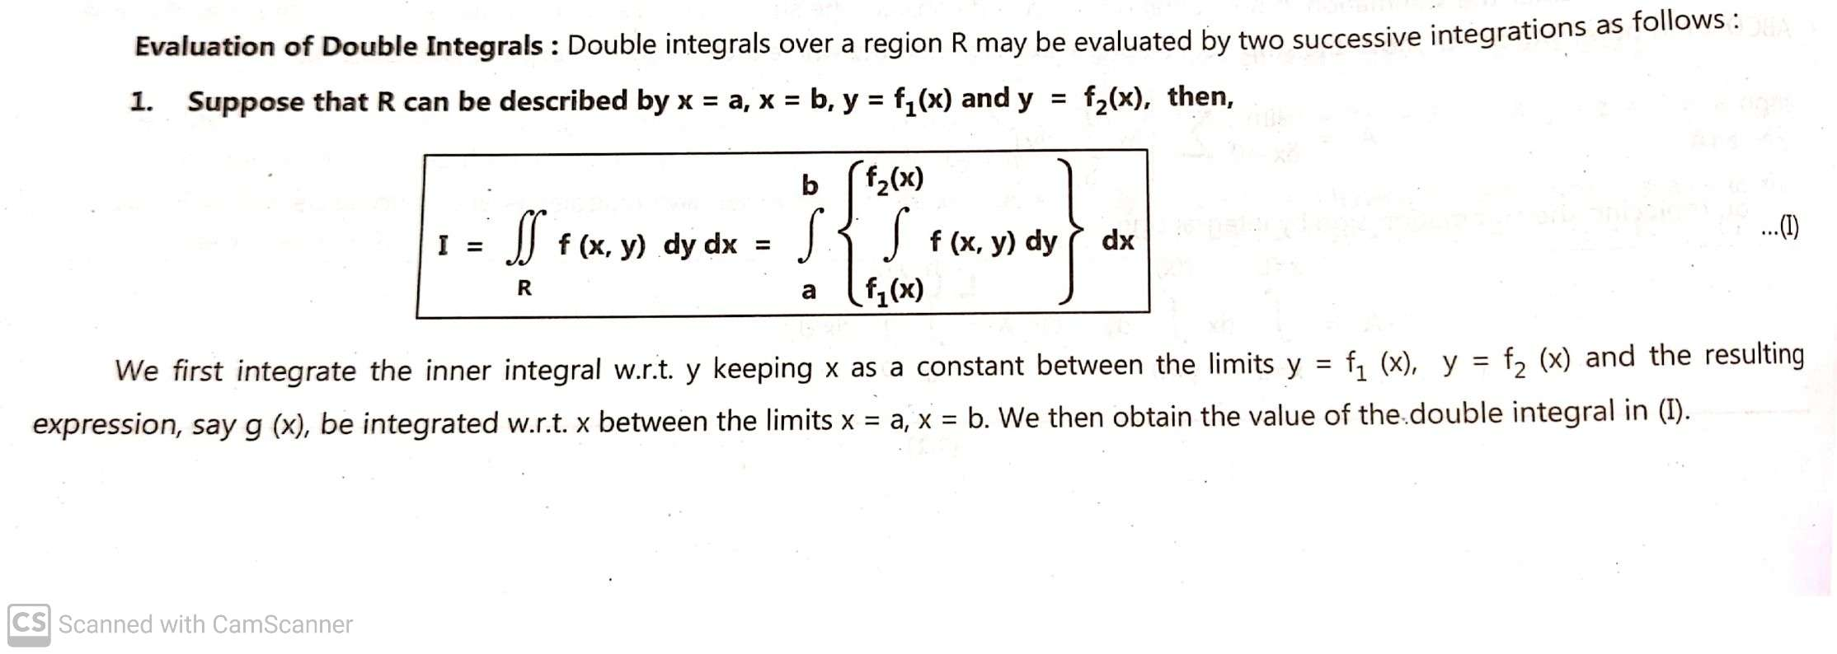
Double Integration:

Slide 5
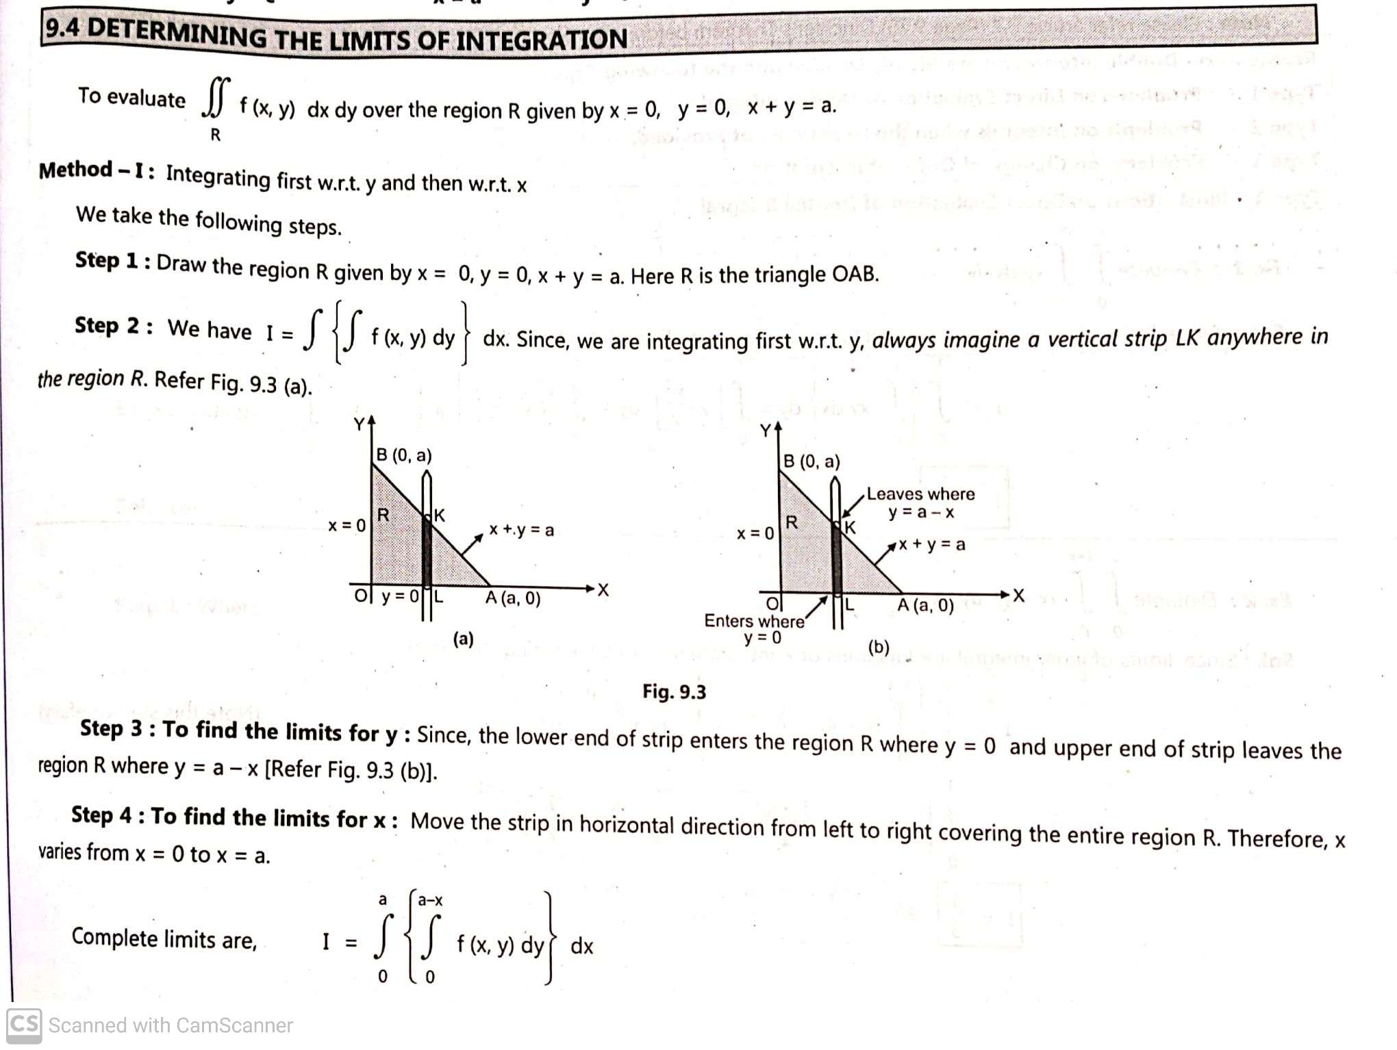

Slide 6
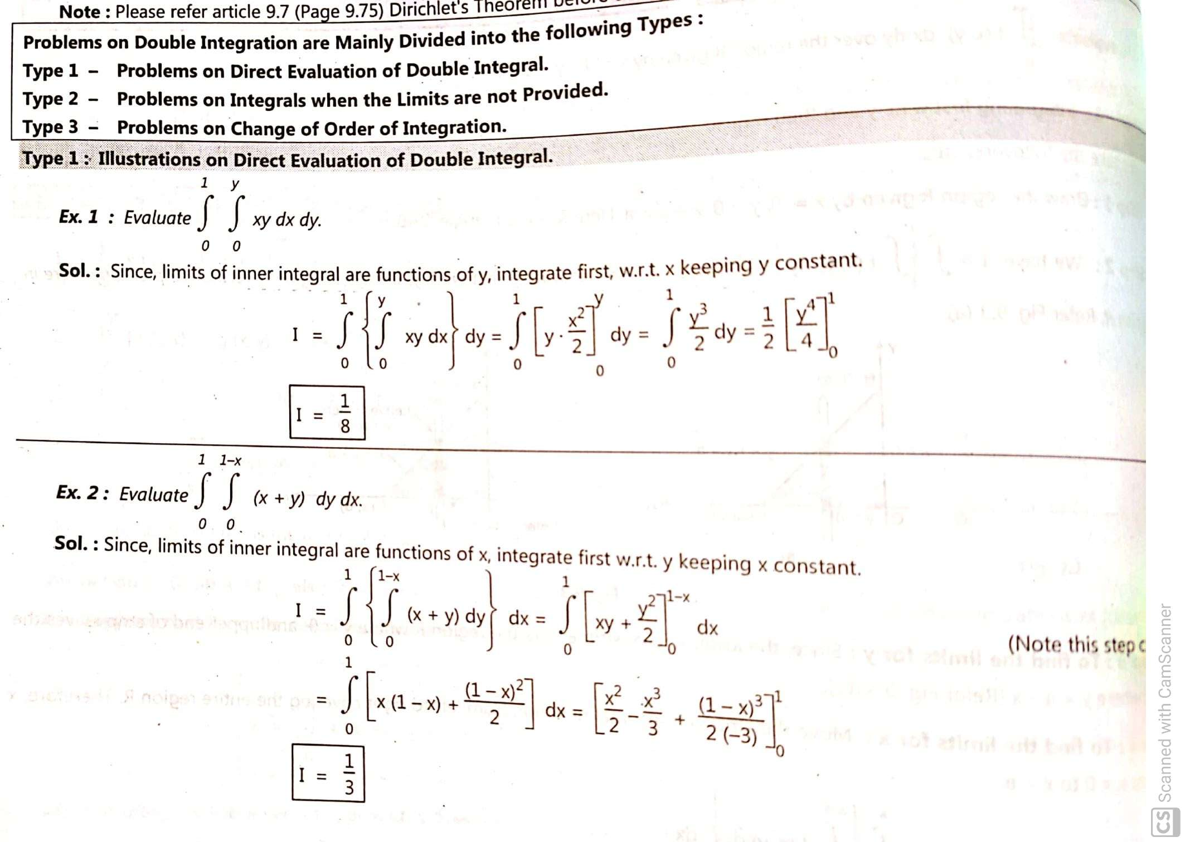

Slide 7
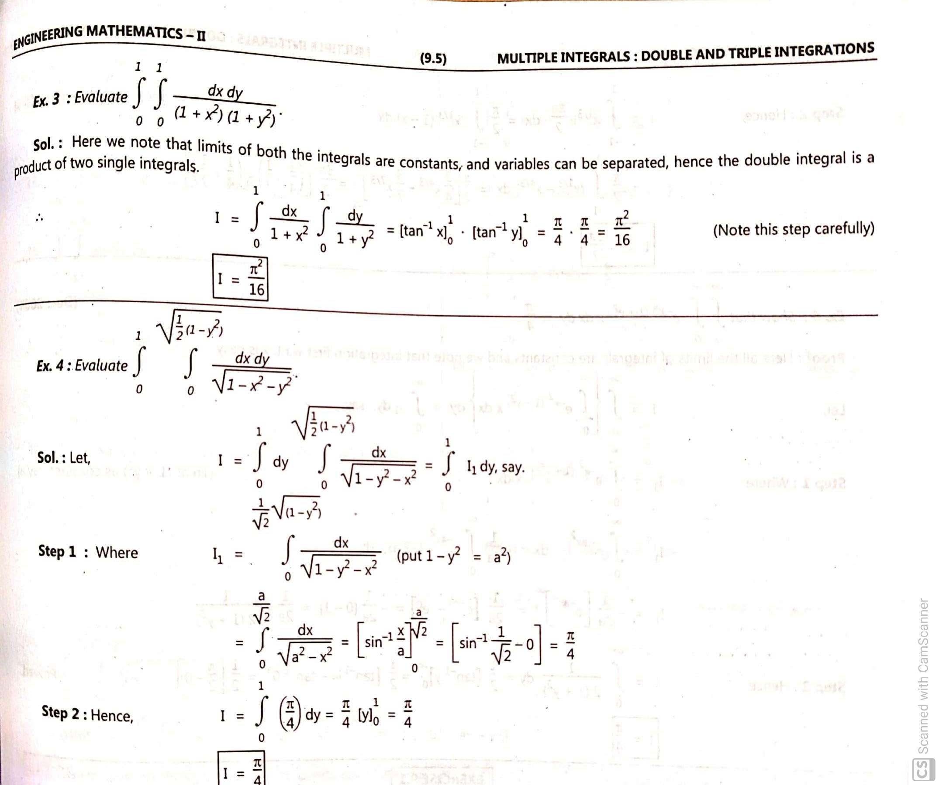

Slide 8
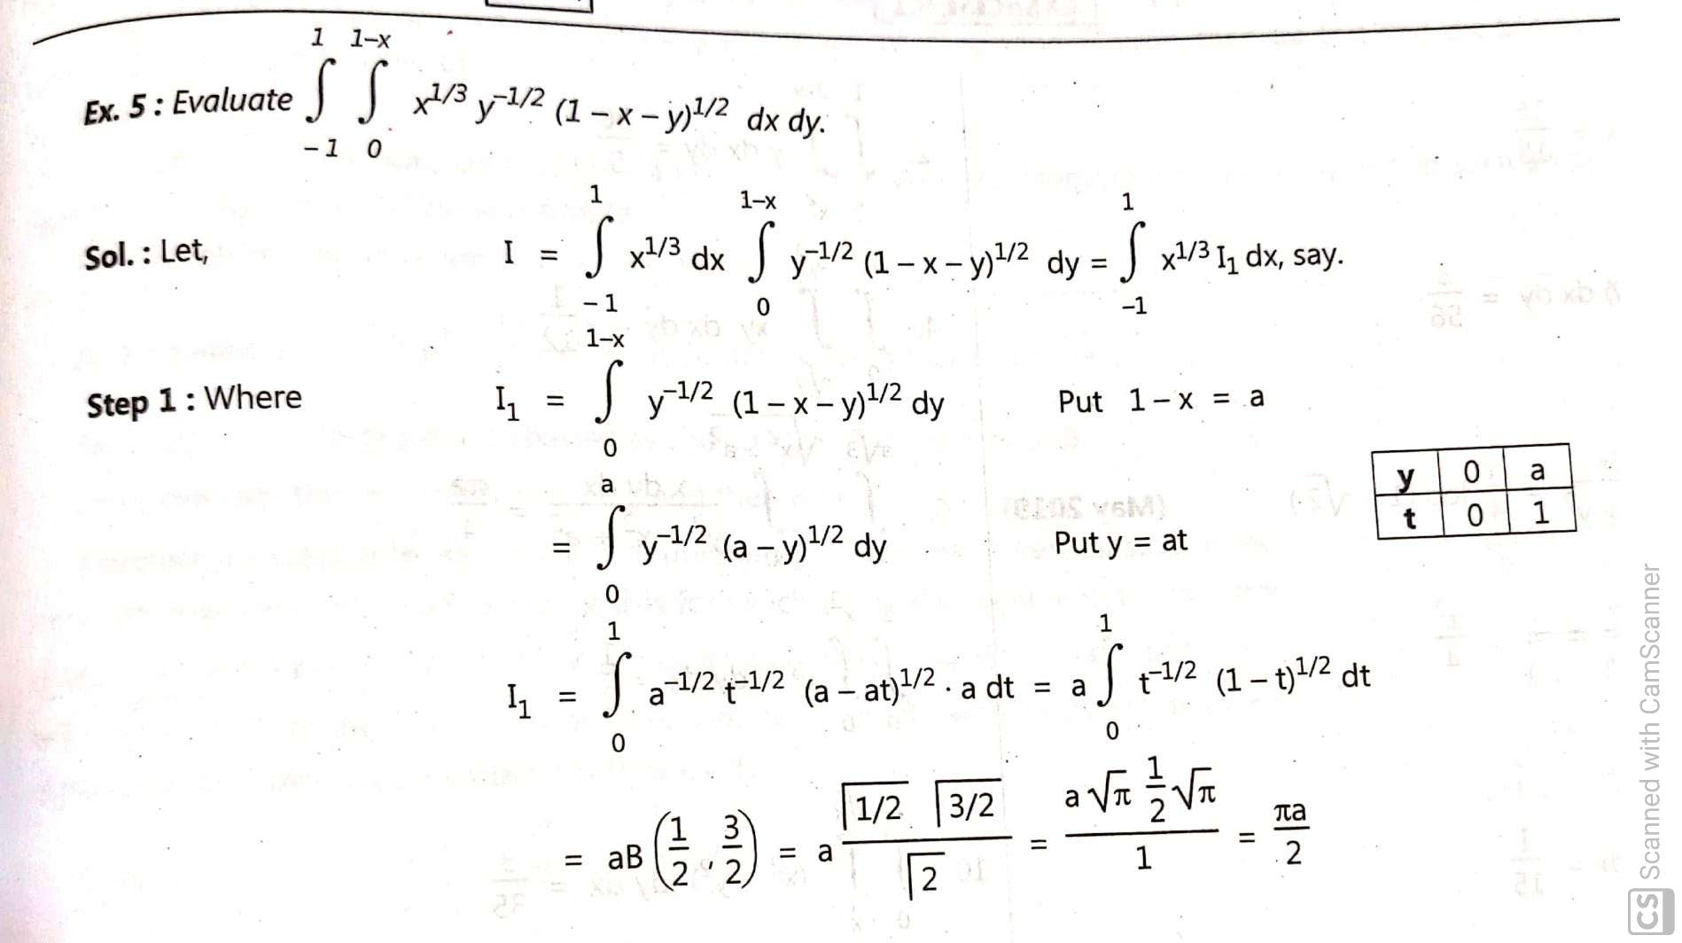

Slide 9
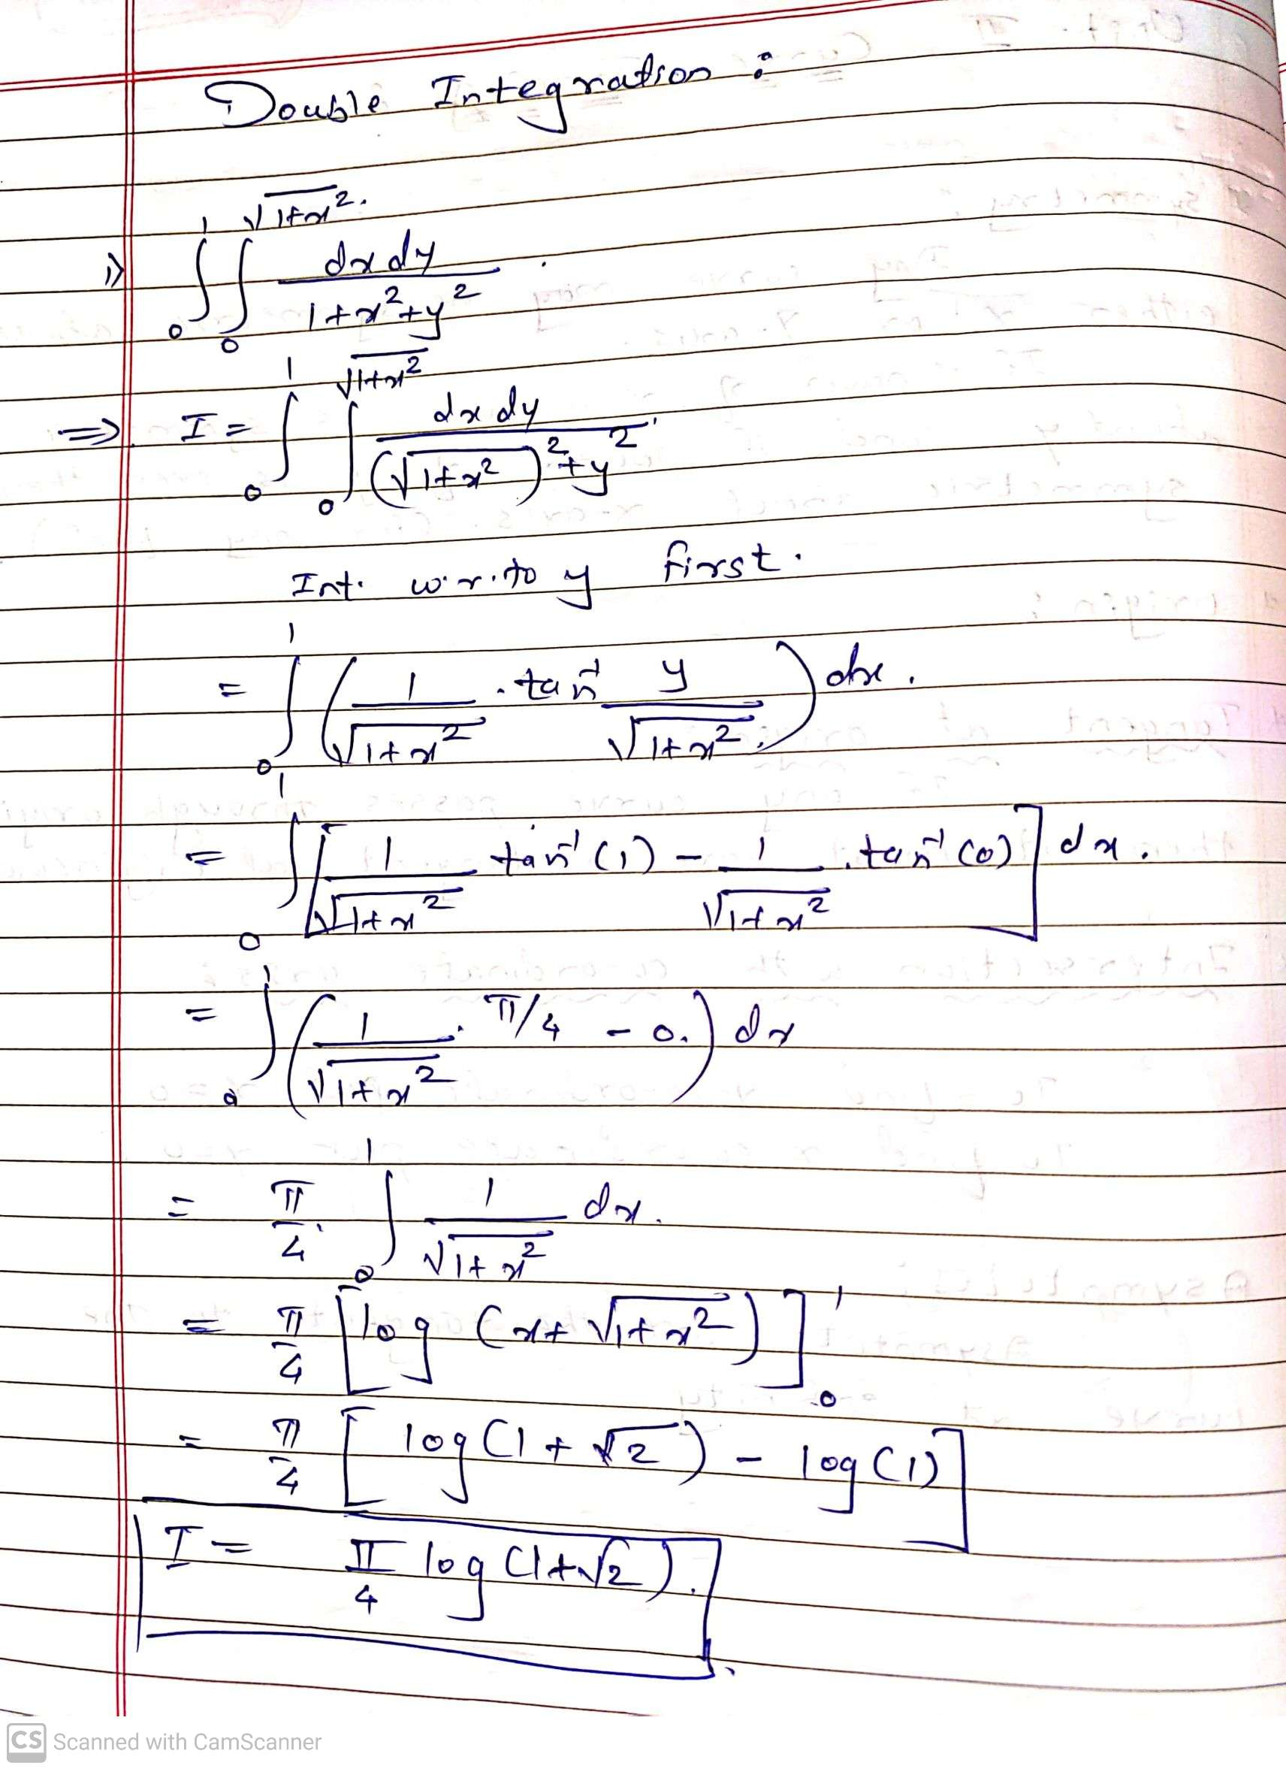

Slide 10
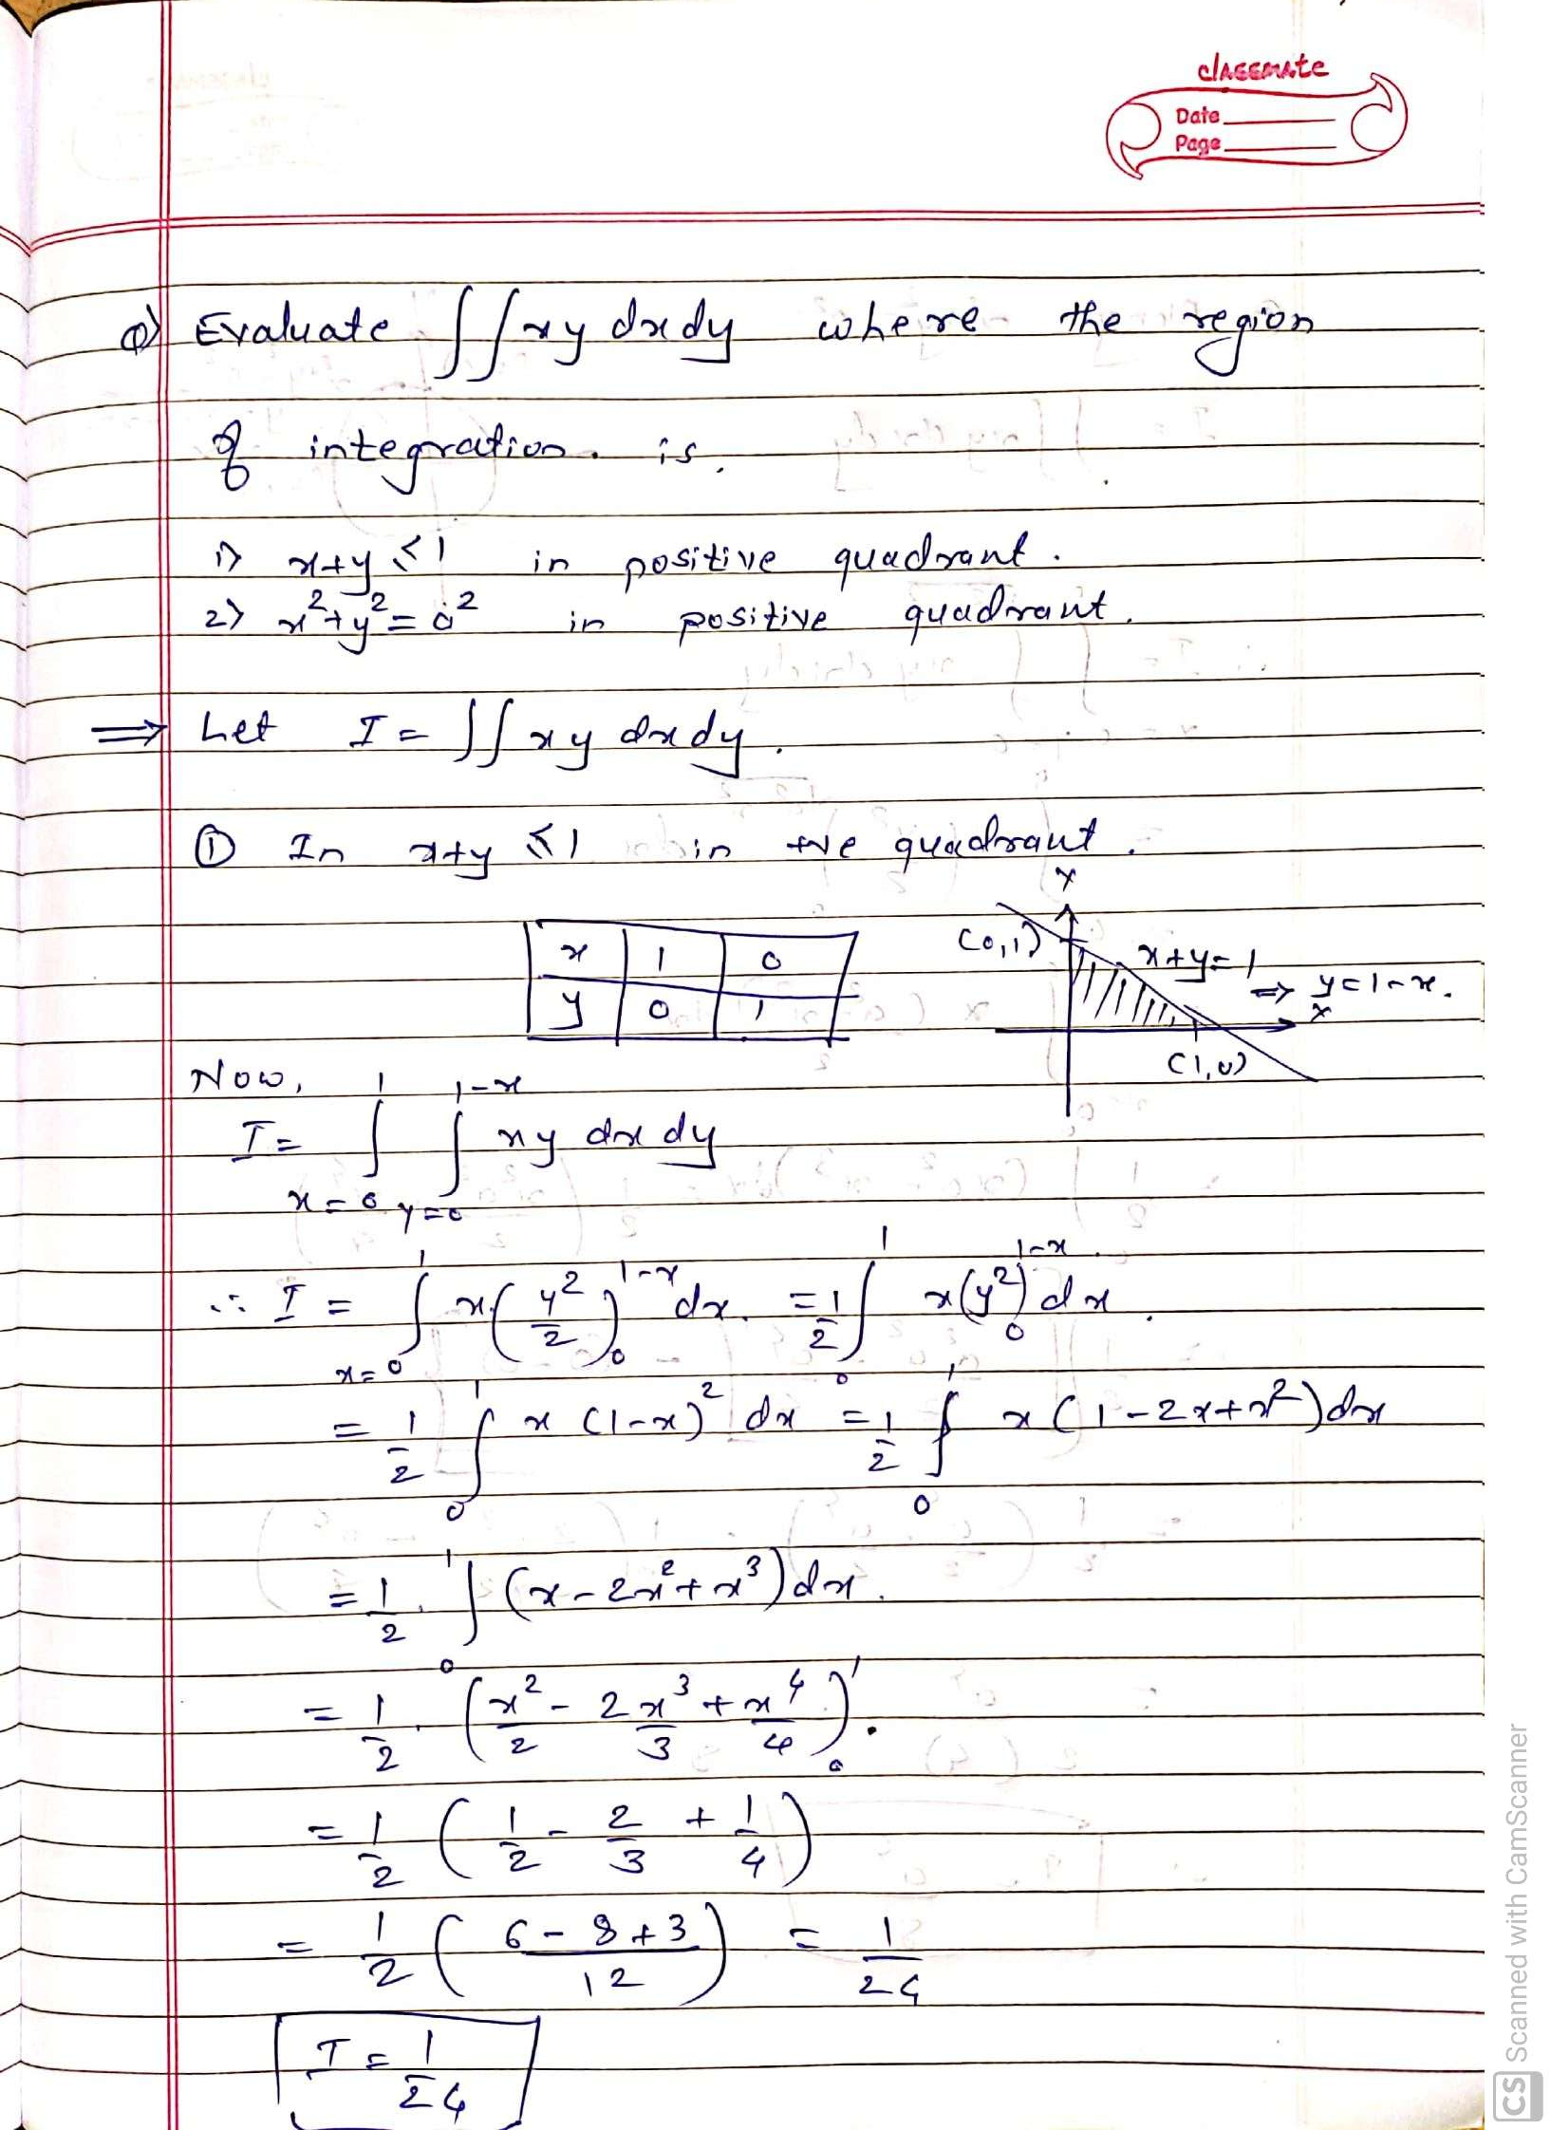

Slide 11
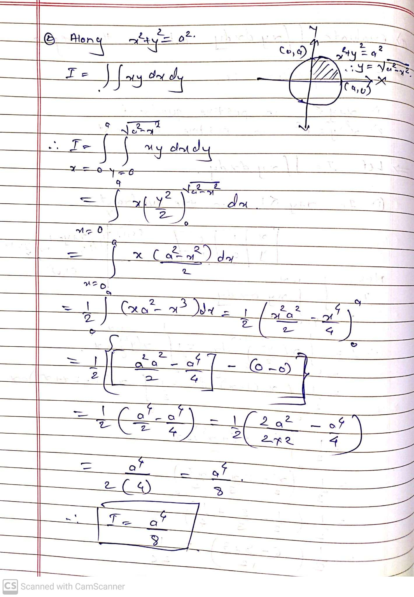

Slide 12
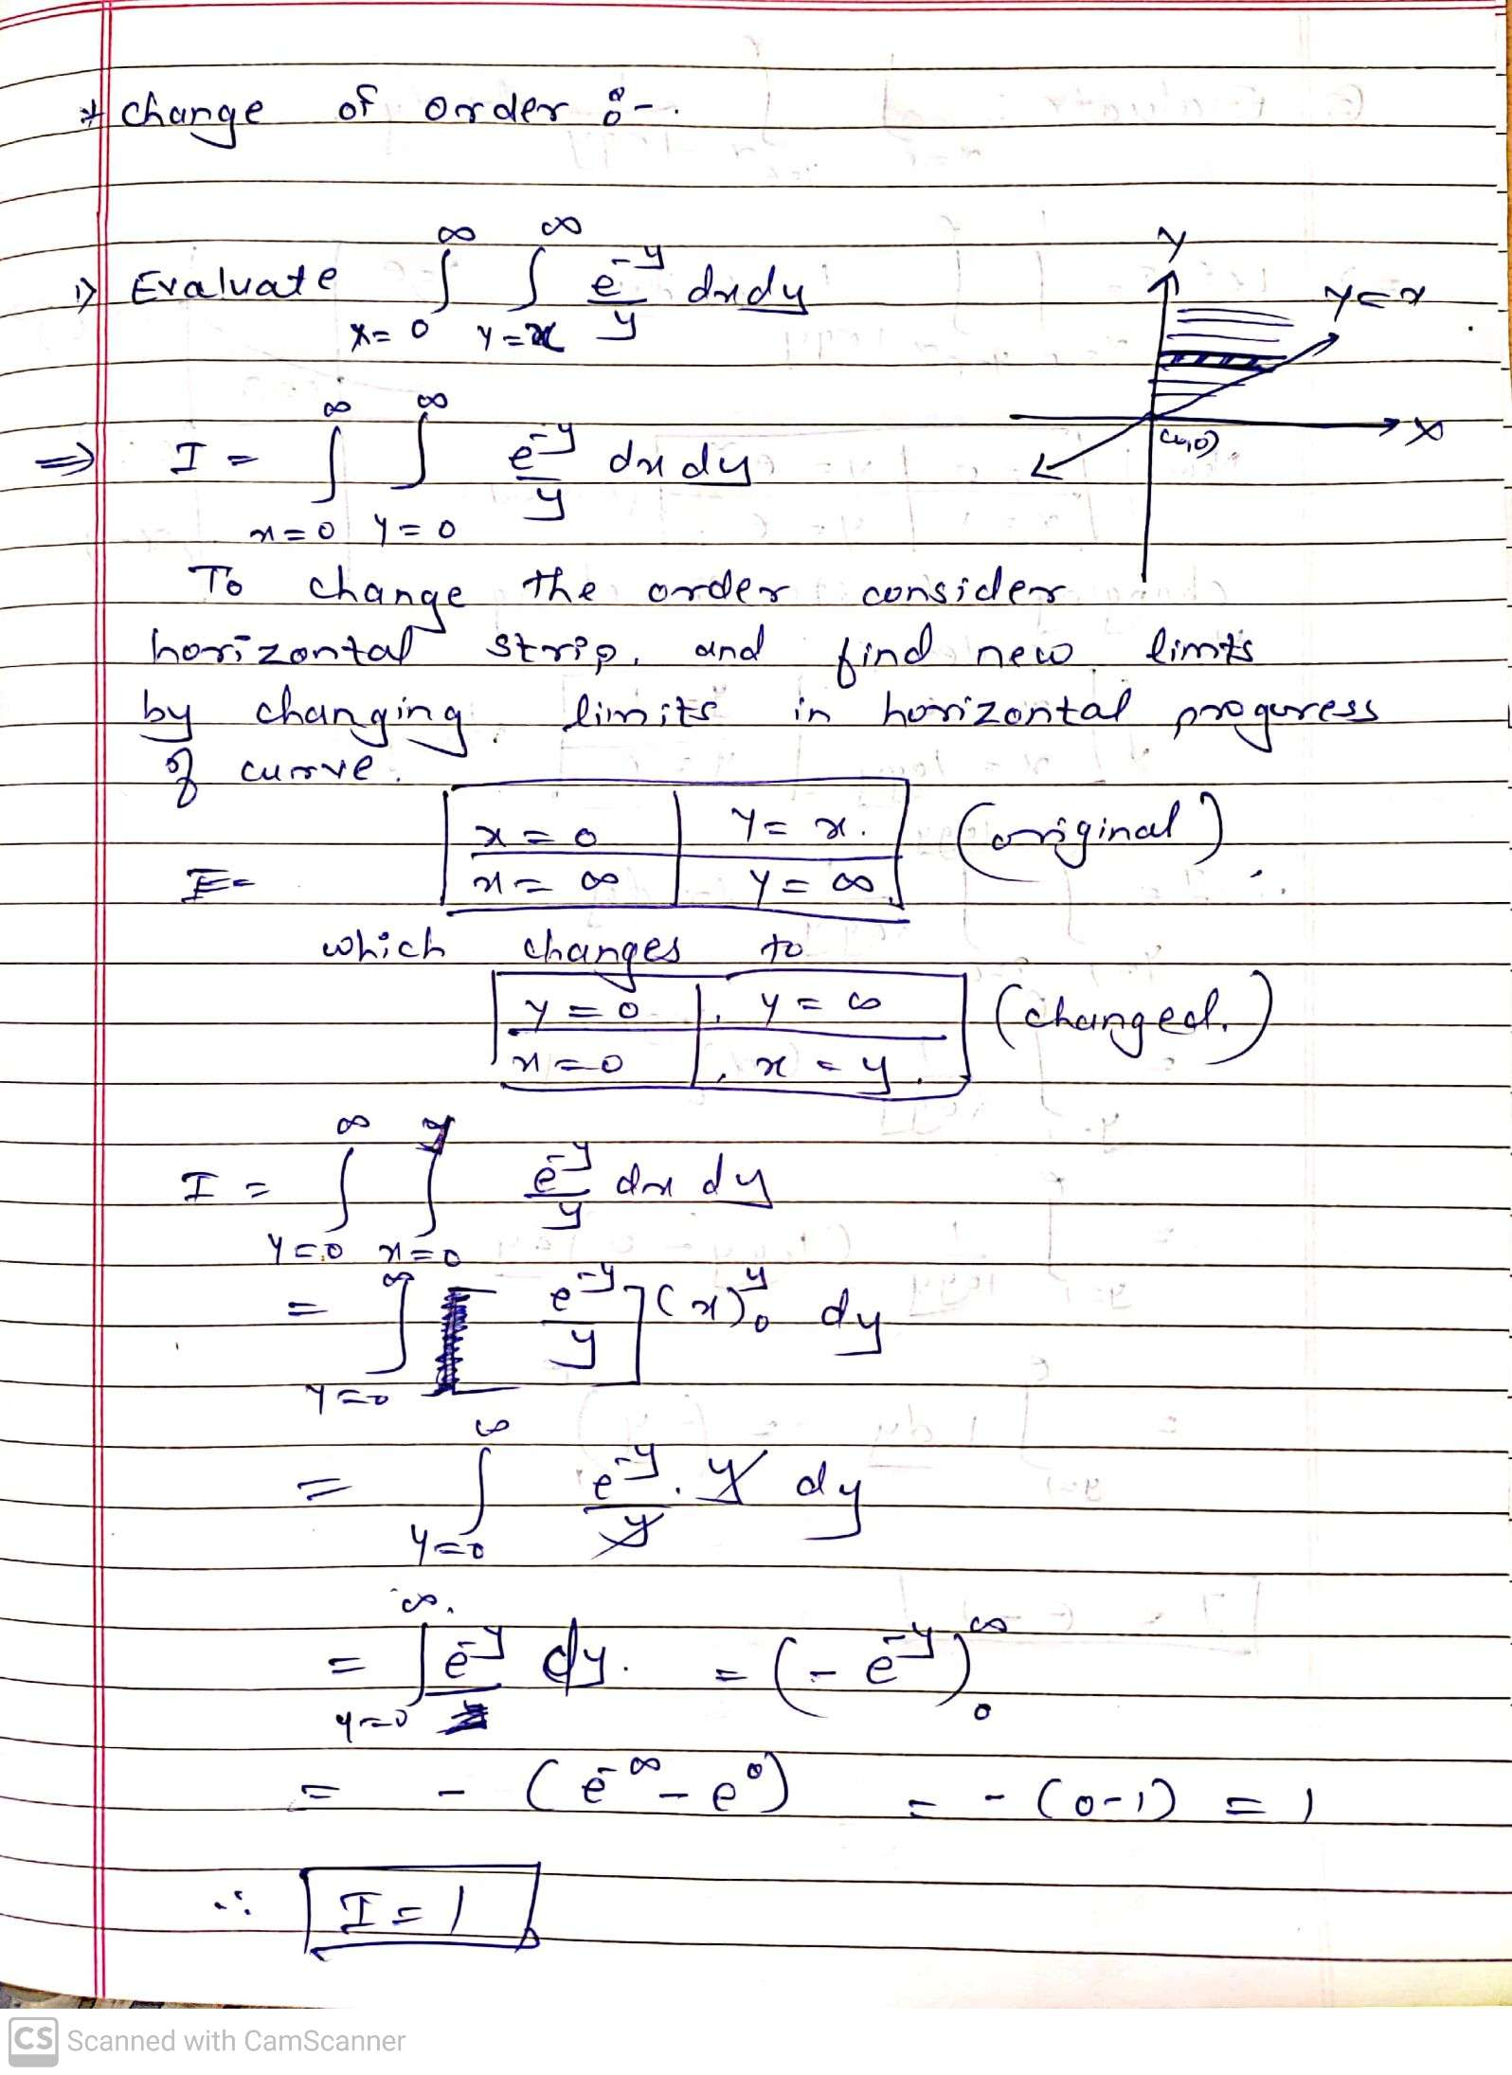

Slide 13
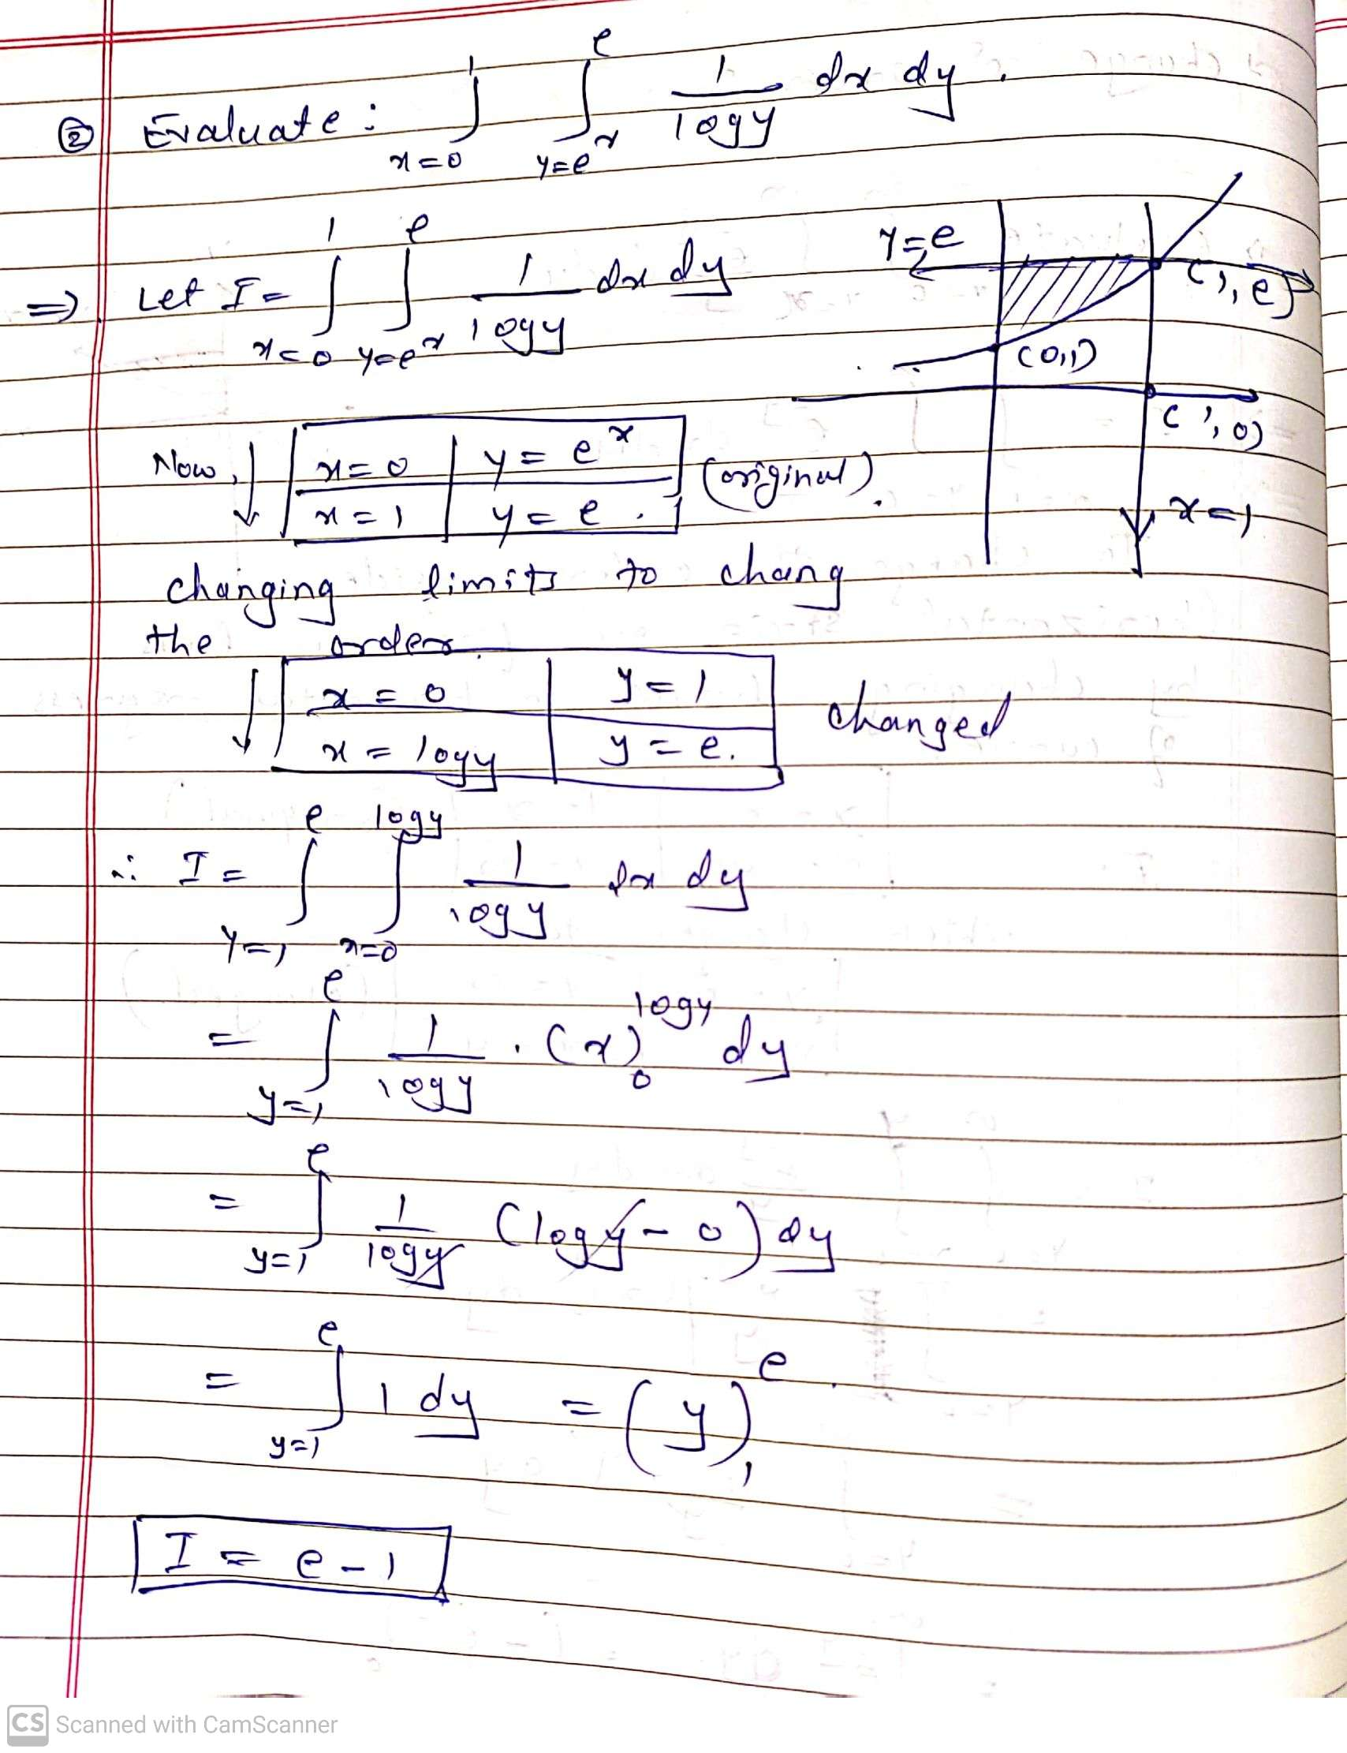

Slide 14
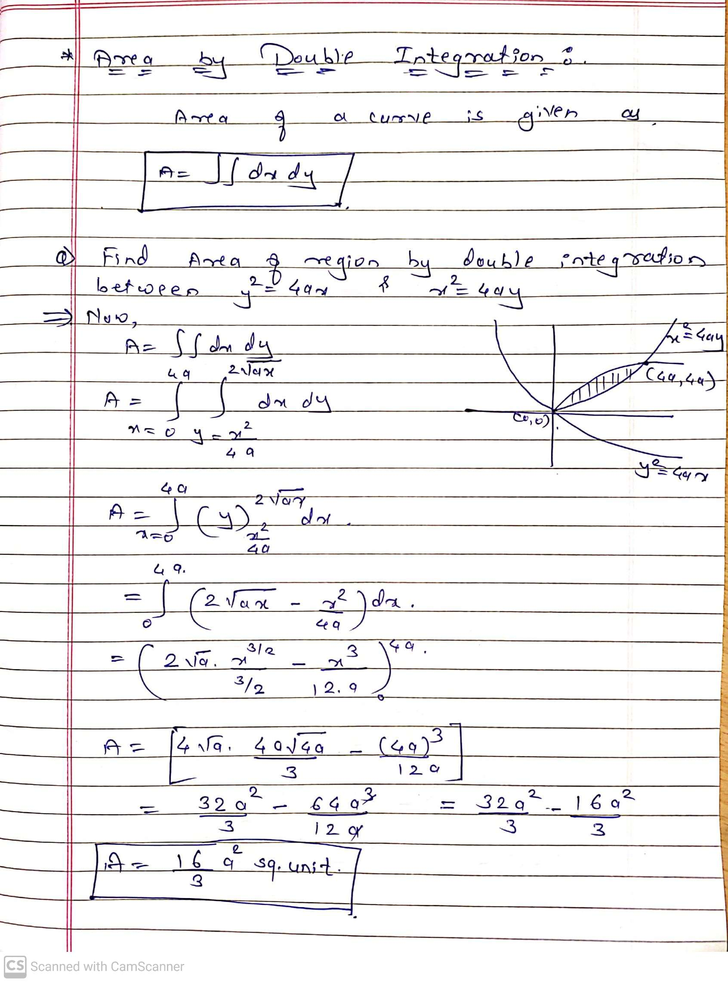

Slide 15
Today we have learnt double integration, change of order and application of double integration to find Area of given curve .
We remain with Triple integration and volume,….

Slide 16


